Slide 1

Texas Parks & Wildlife Department
Ega Sesha Sai, Karumanchi Vinay, Komatireddy Sandeep,
Kondula Kishore, Pulipati Chandra

Slide 2
Abstract
Finding the patterns in socioeconomic and cultural backgrounds of the customers has been a challenge but this helped us group the TPWD customers into meaningful and well spread segments with varying demographics. Considering demographic and labor statistics, variables such as Income, Employment, Race, Age, Gender and Population
The research aims at segmenting the customers based on geographic information like, the customer’s address and other demographic information like customer behavior, likes and dislikes, income etc. to name a few.
An insight on the segment of customers who are most valuable to the department in terms of how frequently they come back, how much revenue they generate and how recently the customer has brought business to the department
By understanding the spending time, money and interest on the hunting, we developed metrics that would help us in finding the customers in different categories like
Spending characteristic – those who are spending more money
Participation – those who are participating in hunting more frequently and more recently

Slide 3
Introduction
Hunting as a hobby or sport not only generate huge revenue and employment but also helps in keeping check on the population of certain species that might otherwise exceed the carrying capacity of their habitat and threaten the well-being of other wildlife species.
In 2011, 13.7 million people went for hunting and spent about 33.7 billion, on activities related to hunting, this number grew from 25.5 billion in 2006 which is 32.26% growth in the spending.
Today’s hunters come from a broad range of economic social and cultural backgrounds. Owing to the revenue hunters generate and their diverse backgrounds makes it important to study their spending time and money on hunting, it is also important to study their socioeconomic backgrounds that would help us to not only serve the customers better but also might help us to find new customers.

Slide 4
Data
MS Access Tables (20+)
Converted database tables to excel sheets for importing data into SAS
Excel sheets of data
Imported Excel sheets to SAS for further analysis
3 consolidated datasets are created using TPWD meta data (TPWD data dictionary)
SAS Data Sets
Converted whole data into 3 least related datasets for analysis (customers, hunt, preference points)
Final Data set is created using above data sets and census data
This is used for RFM analysis and market segmentation and profiling
Consolidated SAS Data Set
Converted the application centric data into applicant centric data
Imputation is done for missing values
New Metrics also created for further analysis

Slide 5

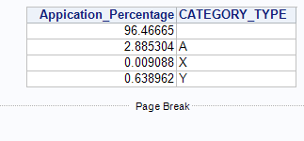
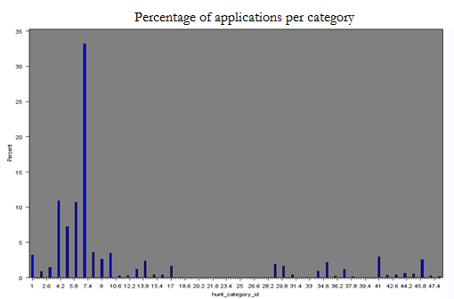
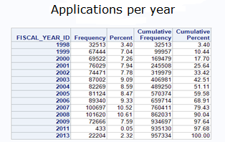
Preliminary analysis
Some preliminary analysis was done on this dataset to understand some basic characteristics of the customers like
Average number of applications per category per year
Number of application per year
Distribution of preference points in each category
The distribution of youth and adults in the hunts

Slide 6
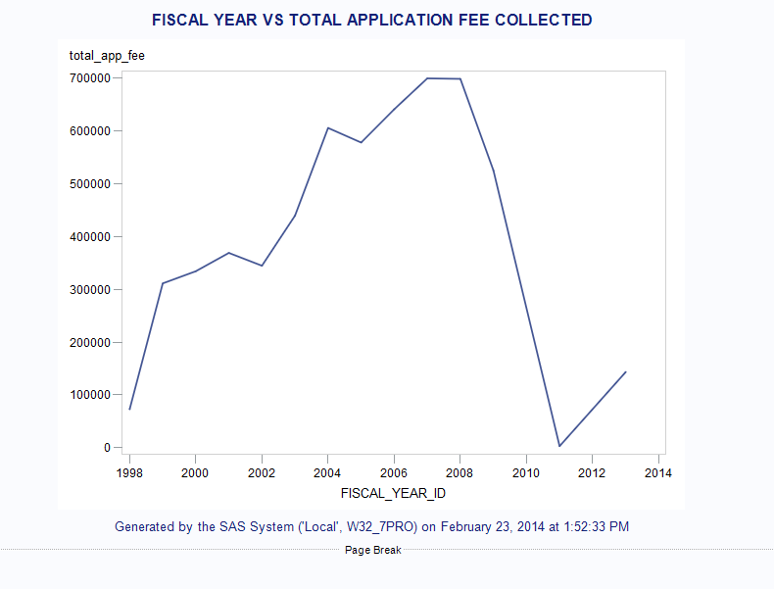
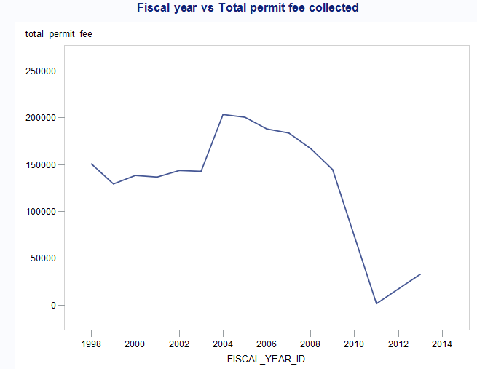
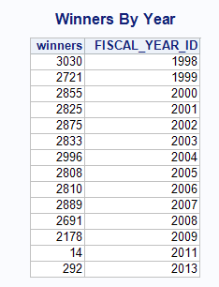
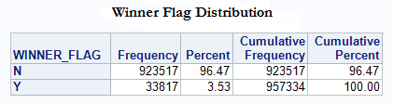
Data Analysis (Contd.)

Slide 7
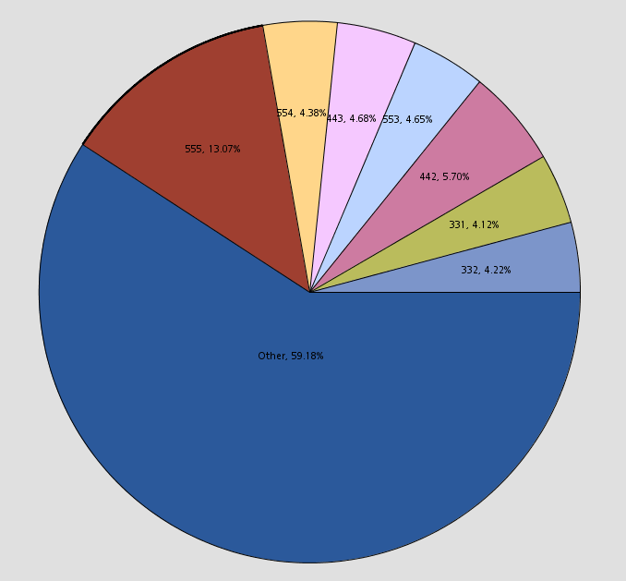
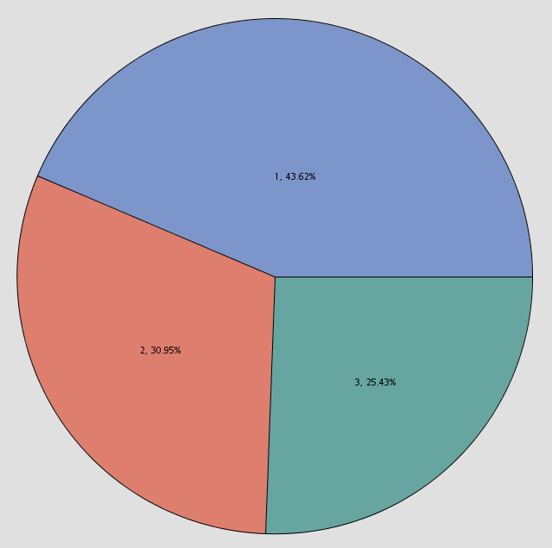
RFM Analysis
To perform RFM analysis, we needed to identify below customer characteristics
Recency – The recent hunt year customer applied
Frequency – Number of applications an applicant is involved in over the years
Monetary – Total application fee that the applicant paid over the years
Chart of RFM groups
Categorized RFM Groups

Slide 8
RFM Analysis (Contd.)
Top 100 locations that the most profitable customers are coming from

Slide 9
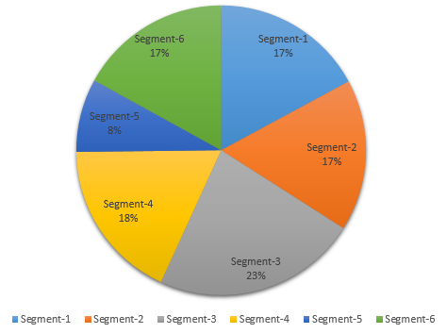
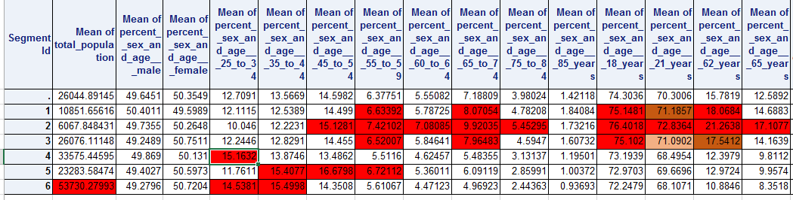
Customer segmentation using demographics
This part of the analysis was mainly focused on determining customer segments with varying demographics.
We considered demographic and labor statistic variables like income, benefits, gender, race, nationality, age group etc., with the zip codes.
We found a good six segment customer profiles with a well spread variation

Slide 10
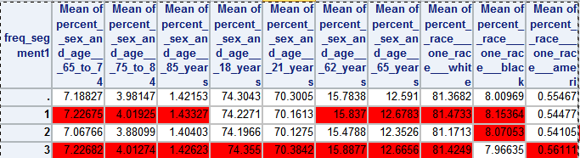
Customer segmentation using Frequency
The analysis was done on the binned frequency variable of the customers. RFM groups 1 and 2 are categorized as 1, groups 3 and 4 are categorized as 2 and group 5 is categorized as 3.
Profiling is run on these clusters with demographic information as the base variables.
Customers who apply all the times—Segment-3,
Customers who apply sometimes—Segment-2,
Customers who apply few times—Segment-1.

Slide 11

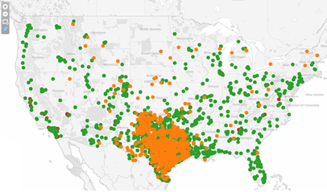
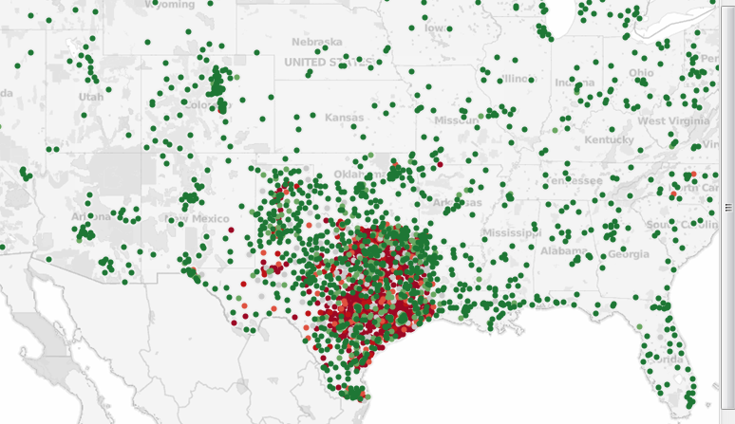

Customer Location Visualization
Exported the data into excel files with zip codes in SAS EG®
Tableau® was used to visualize the zip codes into an interactive map
The majority of customers were from the state of Texas and Oklahoma. However, a lot of customers do exist from across the nation including Alaska and Hawaii.
Majority of the customers are originating from rural areas

Slide 12
Conclusion
Customer segmentation and profiling is done based on demographics and customer characteristics
Customer location visualization is accomplished through Tableau®
Campaigns can be created using segmentation and profiling
Best customers (66.27% ) are identified quantitatively using RFM analysis

Slide 13
For more details contact presenters at:
Name: Sesha Sai Ega Email: seshasai.ega@gmail.com www.linkedin.com/in/seshasaiega/ | Name: Karumanchi Vinay Email: vinaykarumanchi2@gmail.com www.linkedin.com/pub/vinay-karumanchi/7a/641/53
Name: Komatireddy Sandeep Email: sandy195@gmail.com www.linkedin.com/pub/sandeep-komatireddy/2b/641/559 | Name: Kondula Kishore Email: kskish@gmail.com www.linkedin.com/pub/krishna-sai-kishore-konudula/52/6a5/863
Name: Chandra Shekar Pulipati Email: chandu6963@gmail.com www.linkedin.com/pub/chandra-shekar-pulipati/44/912/92

